Slide 1

Chapter 21
Introducing the HTML 5 Canvas

Slide 2
Learning Objectives
How to create a canvas using the <canvas> and </canvas> tag pair
How to test if a browser supports canvas operations
How to position a drawing point using the moveTo function
How to draw lines on the canvas using the lineTo function
How to draw a square or rectangle using the rect function
How to draw circles and arcs using the arc function
How to integrate photos into the canvas
How to display text within the canvas
How to draw curved lines within the canvas

Slide 3
How not to use the canvas
The HTML 5 canvas is ideal for dynamic content, such as animations, performance dashboards, charts, and so on. Do not use the canvas to display traditional HTML graphics or text—doing so provides no benefit. Instead, if your page requires dynamic content, the canvas is for you.

Slide 4
Testing for canvas support
<!DOCTYPE html> <html> <head> <script> function TestCanvas() { if (document.createElement("canvas")) { alert('Browser supports the Canvas'); } else alert('Browser does not support the Canvas'); } </script> </head> <body onload="TestCanvas()"> </body> </html>

Slide 5
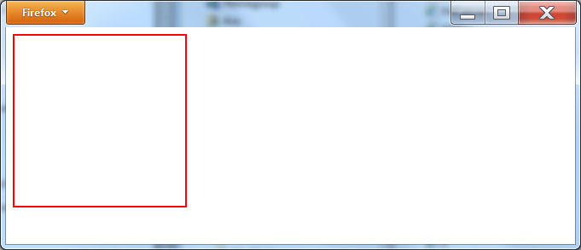
Displaying content on the canvas
<!DOCTYPE html> <html> <body> <canvas width="200" height="200" style="border: 2px solid red;"></canvas> </body> </html>

Slide 6
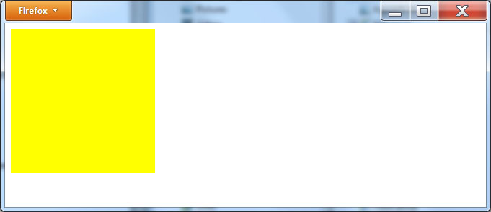
Filling a canvas shape
<!DOCTYPE html> <html> <body> <canvas width="200" height="200" style="background-color:yellow;"></canvas> </body> </html>

Slide 7
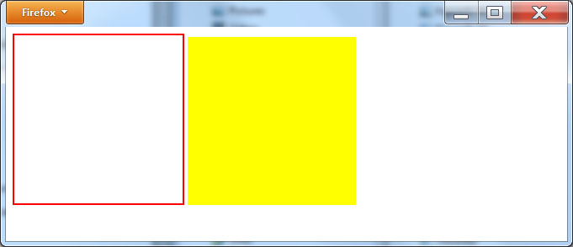
Two canvases
<!DOCTYPE html> <html> <body> <canvas width="200" height="200" style="border: 2px solid red;"></canvas> <canvas width="200" height="200" style="background-color: yellow;"></canvas> </body> </html>

Slide 8
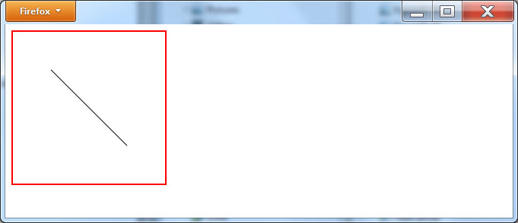
Drawing a line on the canvas
<!DOCTYPE html> <html> <head> <script> function drawLine() { var canvas = document.getElementById('myCanvas'); var context = canvas.getContext('2d'); context.beginPath(); context.moveTo(50,50); context.lineTo(150,150); context.stroke(); } </script> </head> <body onload="drawLine()"> <canvas id="myCanvas" width="200" height="200" style="border: 2px solid red;"></canvas> </body> </html>

Slide 9
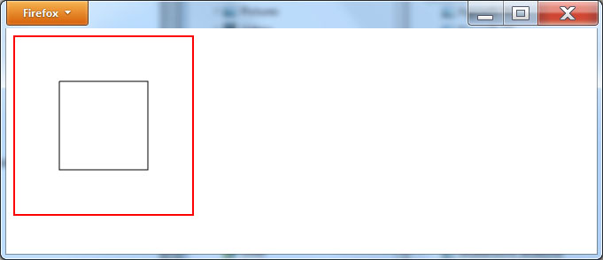
Using canvas lines to draw a square
<!DOCTYPE html> <html> <head> <script> function drawSquare() { var canvas = document.getElementById('myCanvas'); var context = canvas.getContext('2d'); context.beginPath(); context.moveTo(50,50); context.lineTo(50,150); context.lineTo(150,150); context.lineTo(150,50); context.lineTo(50,50); context.stroke(); } </script> </head> <body onload="drawSquare()"> <canvas id="myCanvas" width="200" height="200" style="border: 2px solid red;"></canvas> </body> </html>

Slide 10
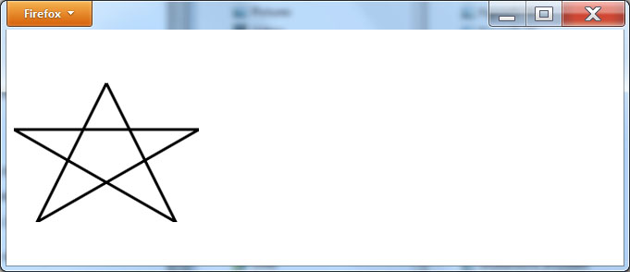
Drawing a thick star
<!DOCTYPE html> <html> <head> <script> function drawStar() { var canvas = document.getElementById('myCanvas'); var context = canvas.getContext('2d'); context.beginPath(); context.moveTo(100,50); context.lineTo(175,200); context.lineTo(0,100); context.lineTo(200,100); context.lineTo(25,200); context.lineTo(100,50); context.lineWidth = 3; context.stroke(); } </script> </head> <body onload="drawStar()"> <canvas id="myCanvas" width="200" height="200"></canvas> </body> </html>

Slide 11
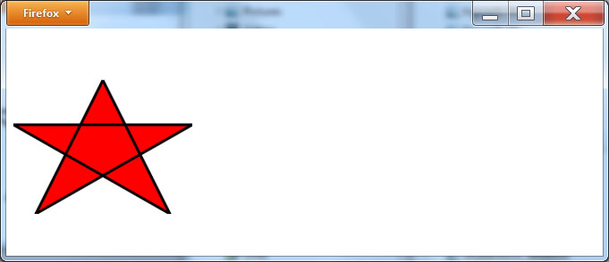
Filling a star
<!DOCTYPE html> <html> <head> <script> function fillStar() { var canvas = document.getElementById('myCanvas'); var context = canvas.getContext('2d'); context.beginPath(); context.moveTo(100,50); context.lineTo(175,200); context.lineTo(0,100); context.lineTo(200,100); context.lineTo(25,200); context.lineTo(100,50); context.lineWidth= 3; context.fillStyle = '#FF0000'; context.fill(); context.stroke(); } </script> </head> <body onload="fillStar()"> <canvas id="myCanvas" width="200" height="200"></canvas> </body> </html>

Slide 12
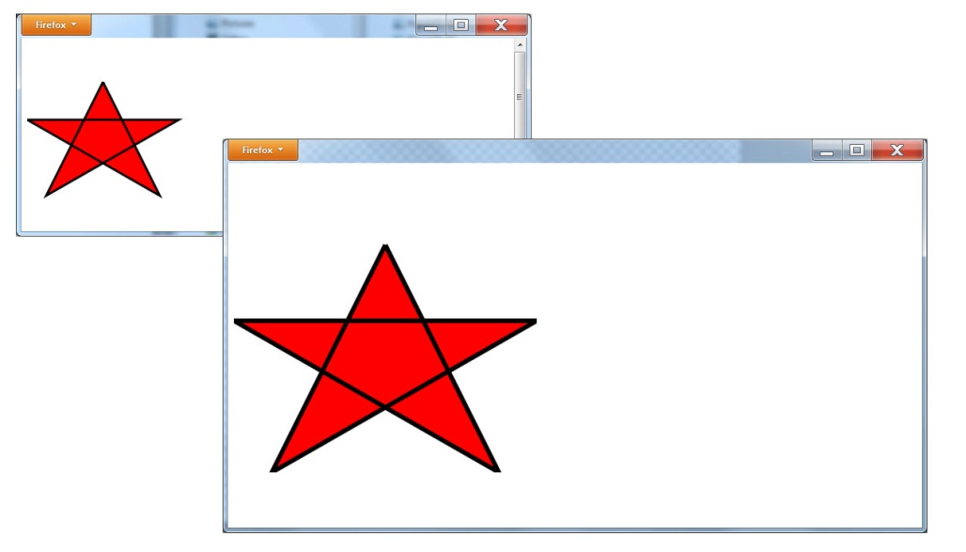
Scaling the canvas
<!DOCTYPE html> <html> <head> <script> function drawStar(scaleX, scaleY) { var canvas, context; canvas = document.getElementById('myCanvas'); context = canvas.getContext('2d'); context.beginPath(); context.clearRect(0, 0, canvas.width, canvas.height); context.scale(scaleX, scaleY); context.moveTo(100,50); context.lineTo(175,200); context.lineTo(0,100); context.lineTo(200,100); context.lineTo(25,200); context.lineTo(100,50); context.lineWidth = 3; context.fillStyle = '#FF0000'; context.fill(); ontext.stroke(); } </script> </head> <body onload="drawStar(1, 1)"> <canvas id="myCanvas" width="400" height="400" onmouseover="drawStar(2, 2);" onmouseout="drawStar(0.5, 0.5);"></canvas> </body> </html>

Slide 13
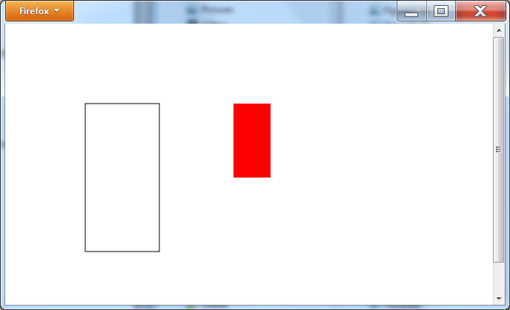
Drawing and filling rectangles
<!DOCTYPE html> <html> <head> <script> function drawRects() { var canvas, context; canvas = document.getElementById('myCanvas'); context = canvas.getContext('2d'); context.rect(100, 100, 100, 200); context.fillStyle = '#FF0000'; context.fillRect(300, 100, 50, 100); context.stroke(); } </script> </head> <body onload="drawRects()"> <canvas id="myCanvas" width="400" height="400"></canvas> </body> </html>

Slide 14
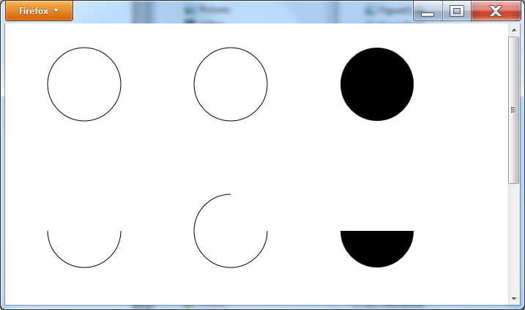
Drawing circles and arcs
<!DOCTYPE html> <html> <head> <script> function drawCircles() { var canvas, context; canvas = document.getElementById('myCanvas'); context = canvas.getContext('2d'); context.beginPath(); context.arc(100,75,50,0,2*Math.PI); context.stroke(); context.beginPath(); context.arc(300,75,50,0,2*Math.PI); context.stroke();
context.beginPath(); context.arc(500,75,50,0,2*Math.PI); context.fill(); context.beginPath(); context.arc(100,275,50,0,1*Math.PI); context.stroke(); context.beginPath(); context.arc(300,275,50,0,1.5*Math.PI); context.stroke(); context.beginPath(); context.arc(500,275,50,0,1*Math.PI); context.fill(); } </script> </head> <body onload="drawCircles()"> <canvas id="myCanvas" width="600" height="600"></canvas> </body> </html>

Slide 15
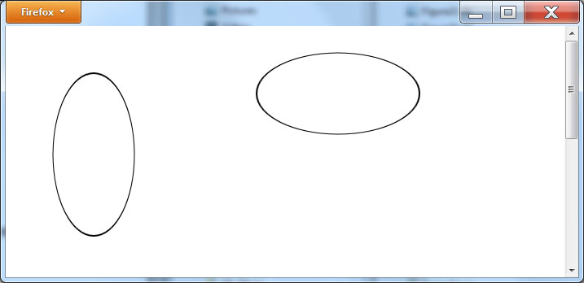
Drawing ellipses
<!DOCTYPE html> <html> <head> <script> function drawCircles() { var canvas, context; canvas = document.getElementById('myCanvas'); context = canvas.getContext('2d'); context.beginPath(); context.scale(1, 2); context.arc(100,75,50,0,2*Math.PI); context.stroke(); context.scale(1, 0.5); context.beginPath(); context.scale(2, 1); context.arc(200,75,50,0,2*Math.PI); context.stroke(); } </script> </head> <body onload="drawCircles()"> <canvas id="myCanvas" width="600" height="600"></canvas> </body> </html>

Slide 16
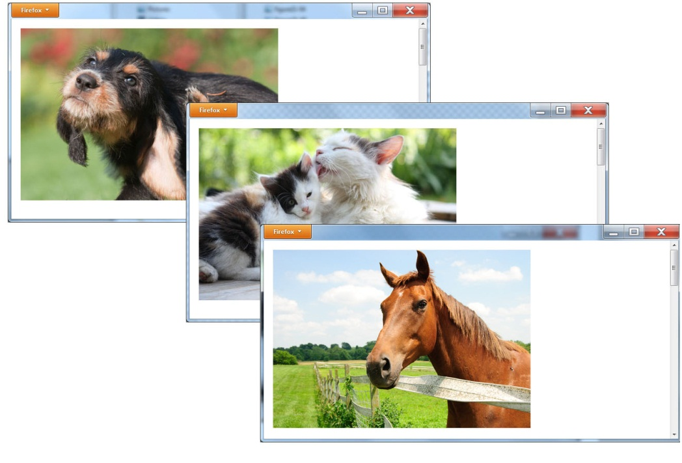
Image-based screen saver
<!DOCTYPE html> <html> <head> <script> vari = 0; function ShowSlide() { var canvas, context; canvas = document.getElementById('myCanvas'); context = canvas.getContext('2d'); context.clearRect(0,0,600,600); if (i == 0) { context.drawImage(document.getElementById("dog"), 10, 10); i++; } else if (i == 1) { context.drawImage(document.getElementById("cat"), 10, 10); i++; } else { context.drawImage(document.getElementById("horse"), 10, 10); i = 0; } setTimeout (ShowSlide, 3000); } </script> </head> <body onload="setTimeout (ShowSlide, 100);"> <canvas id="myCanvas" width="600" height="600"></canvas> <div style="visibility:hidden"> <img id="dog" src="dog.jpg"> <img id="cat" src="cat.jpg"> <img id="horse" src="horse.jpg"> </div> </body> </html>

Slide 17
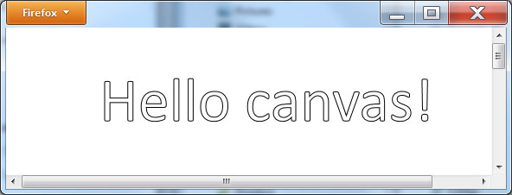
Displaying text within the canvas
<!DOCTYPE html> <html> <head> <script> function sayHello() { var canvas, context; canvas = document.getElementById('myCanvas'); context = canvas.getContext('2d'); context.font = '72px Calibri'; context.strokeText('Hello canvas!', 100, 100); } </script> </head> <body onload="sayHello();"> <canvas id="myCanvas" width="600" height="600"></canvas> </body> </html>

Slide 18
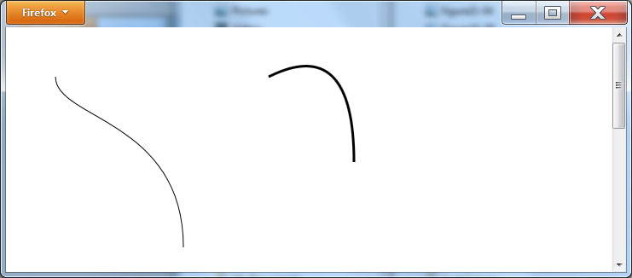
Drawing curved lines
<!DOCTYPE html> <html> <head> <script> function sayHello() { var canvas, context; canvas = document.getElementById('myCanvas'); context = canvas.getContext('2d'); context.beginPath(); context.moveTo(50,50); context.bezierCurveTo(50,100, 200, 100, 200,250); context.stroke(); context.beginPath(); context.moveTo(300, 50); context.quadraticCurveTo(400, 0, 400, 150); context.lineWidth = 3; context.stroke(); } </script> </head> <body onload="sayHello();"> <canvas id="myCanvas" width="600" height="600"></canvas> </body> </html>

Slide 19
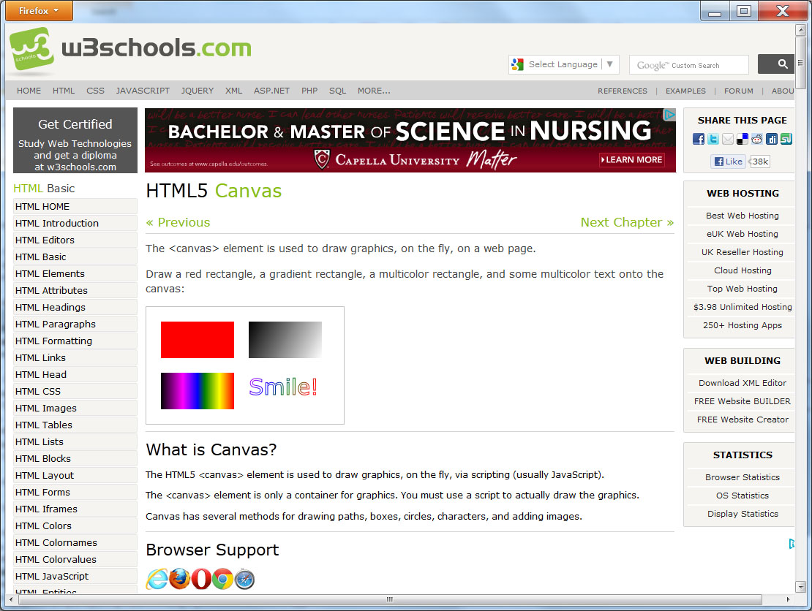
Real World: canvas specification

Slide 20
summary
To help Web developers create interactive content, HTML 5 provides a canvas object, which defines a region in the page where the developer can draw shapes, text, and images dynamically using JavaScript.
This chapter introduced the canvas and simple drawing operations you can perform.

